Slide 1
Airplane Crashes Analysis
Keyan Chen

Slide 2
Contents
01
03
Crashes Dataset
Cluster Analysis
02
04
Crashes V.S. Time
Others

Slide 3
01
Crashes Dataset

Slide 4
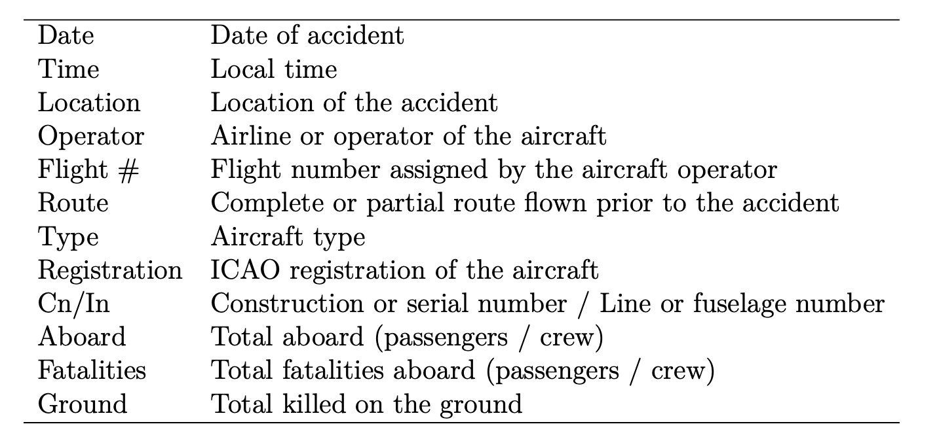
Dataset

Slide 5
Dataset
Dates of crash events range from Sept 1908 to June 2009.
Aeroflot and US Air Force have the highest number of crash events.
Douglas DC-3 has the largest number of crashes.
The mean survival rate is 16.51%.

Slide 6
02
Crashes V.S. Time

Slide 7
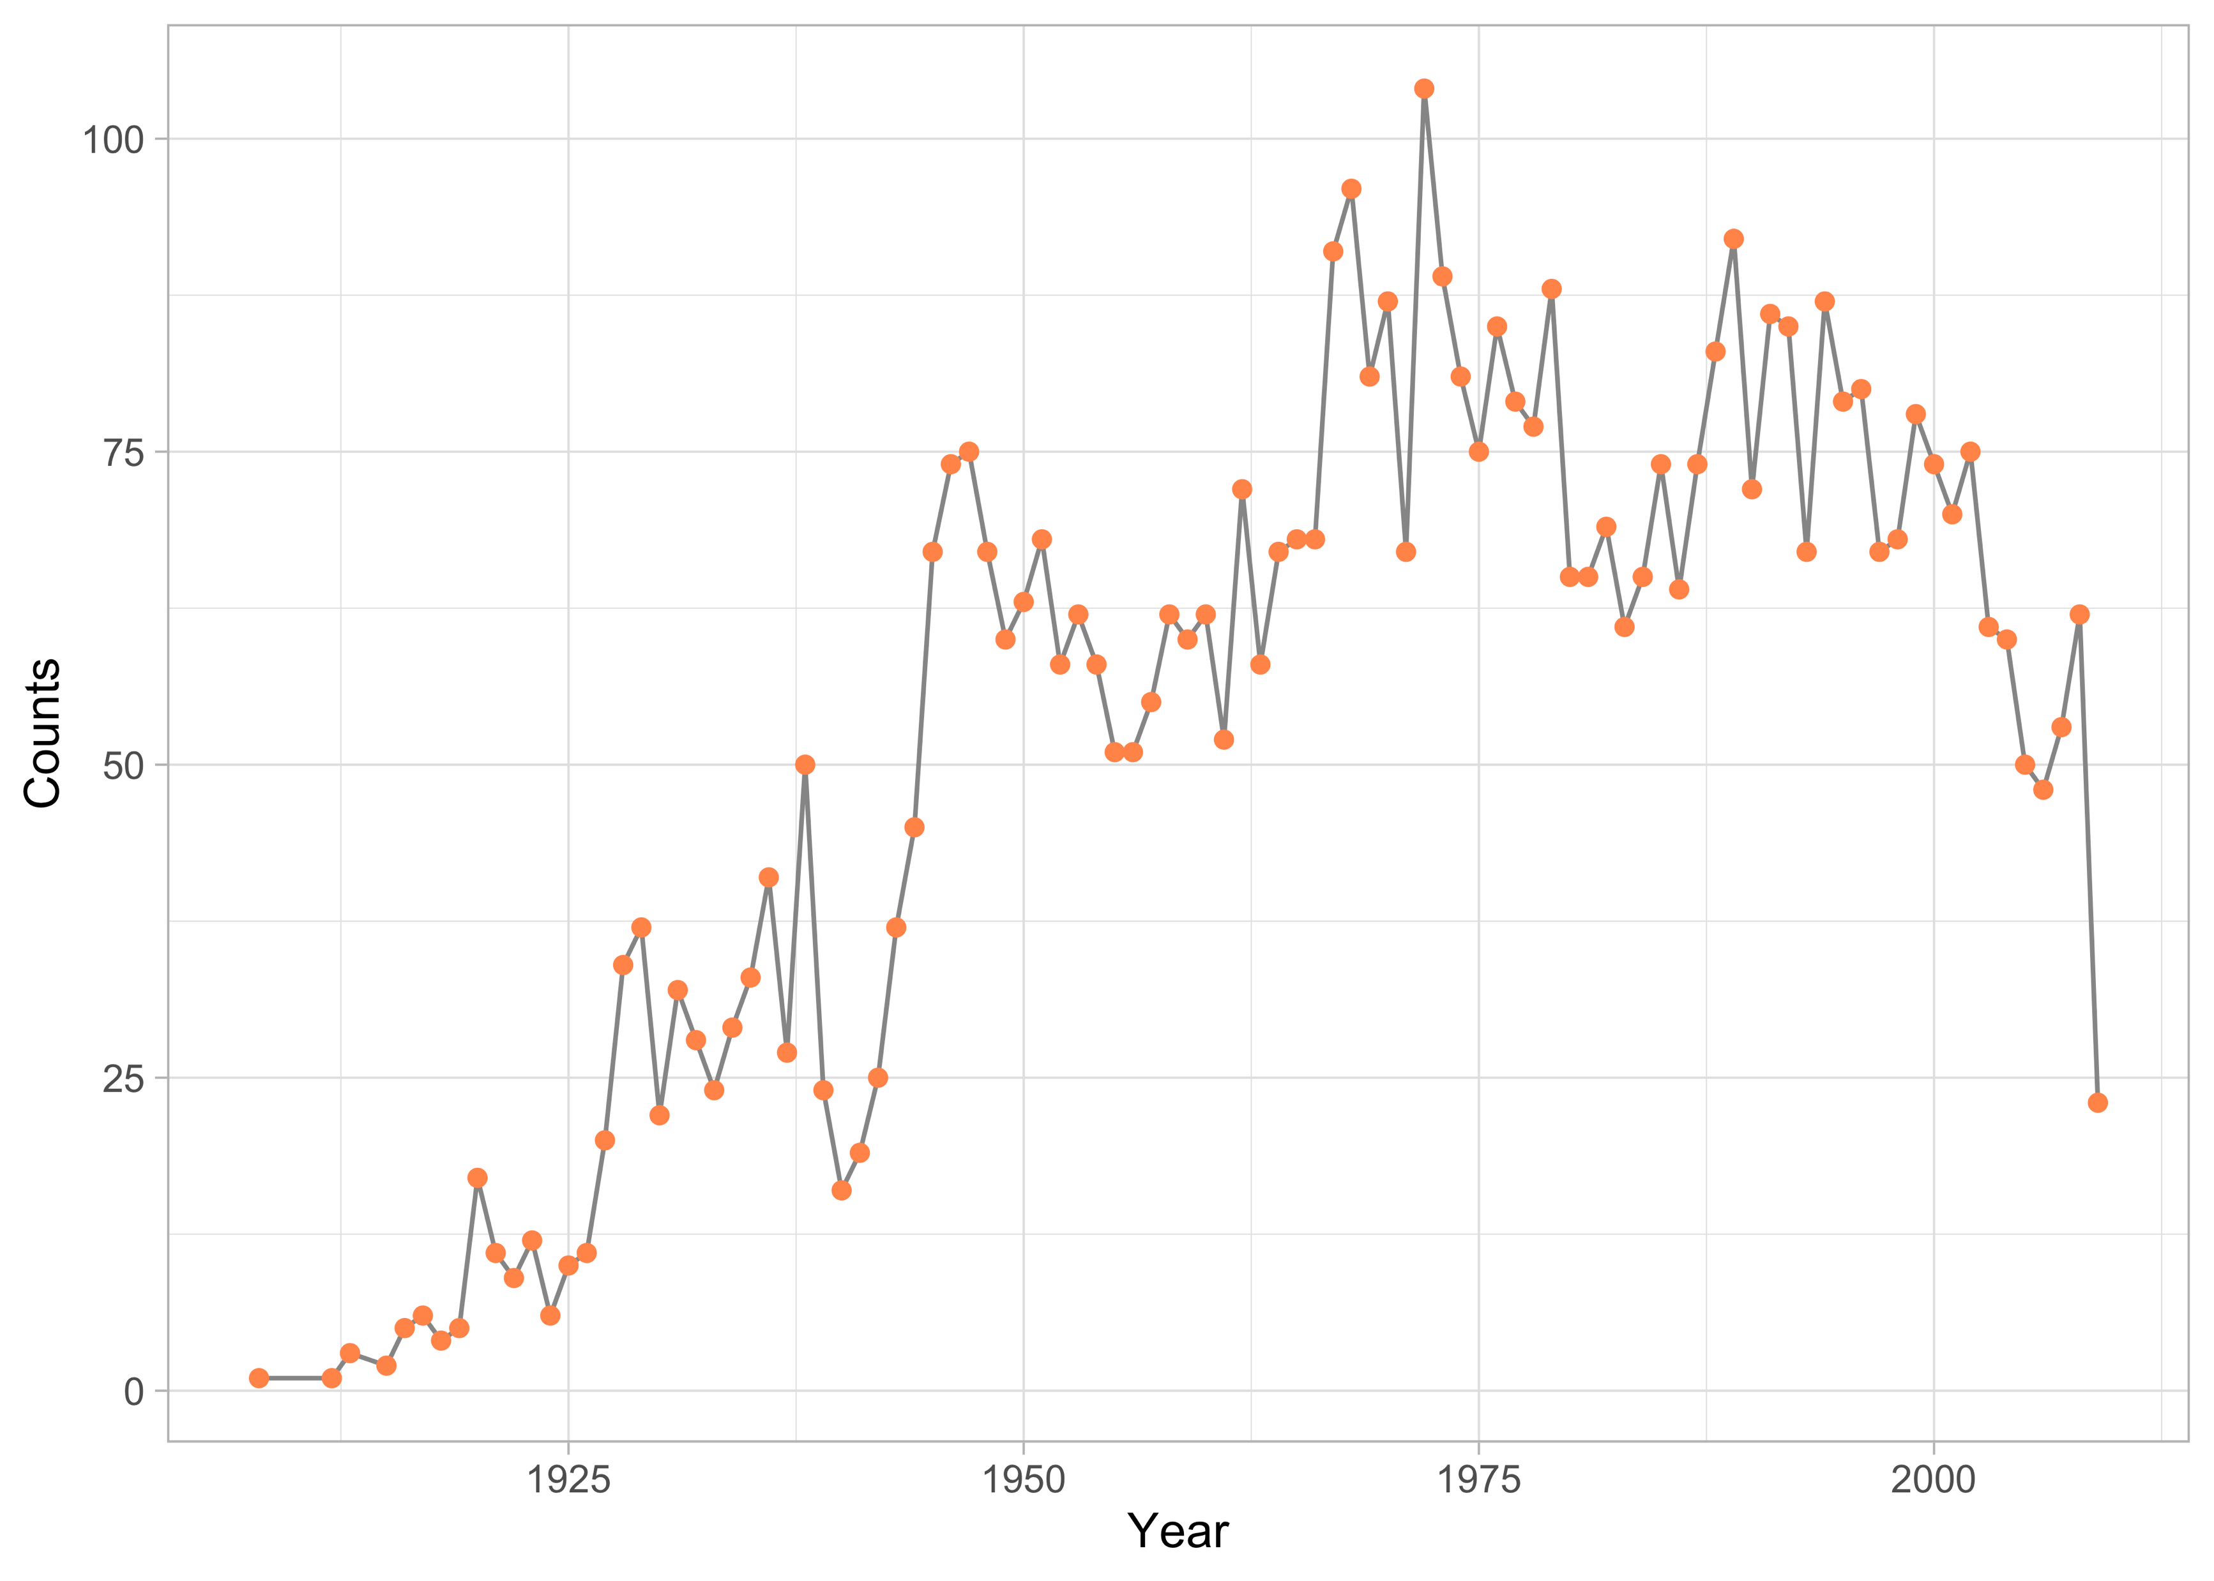
Number V.S. Years

Slide 8
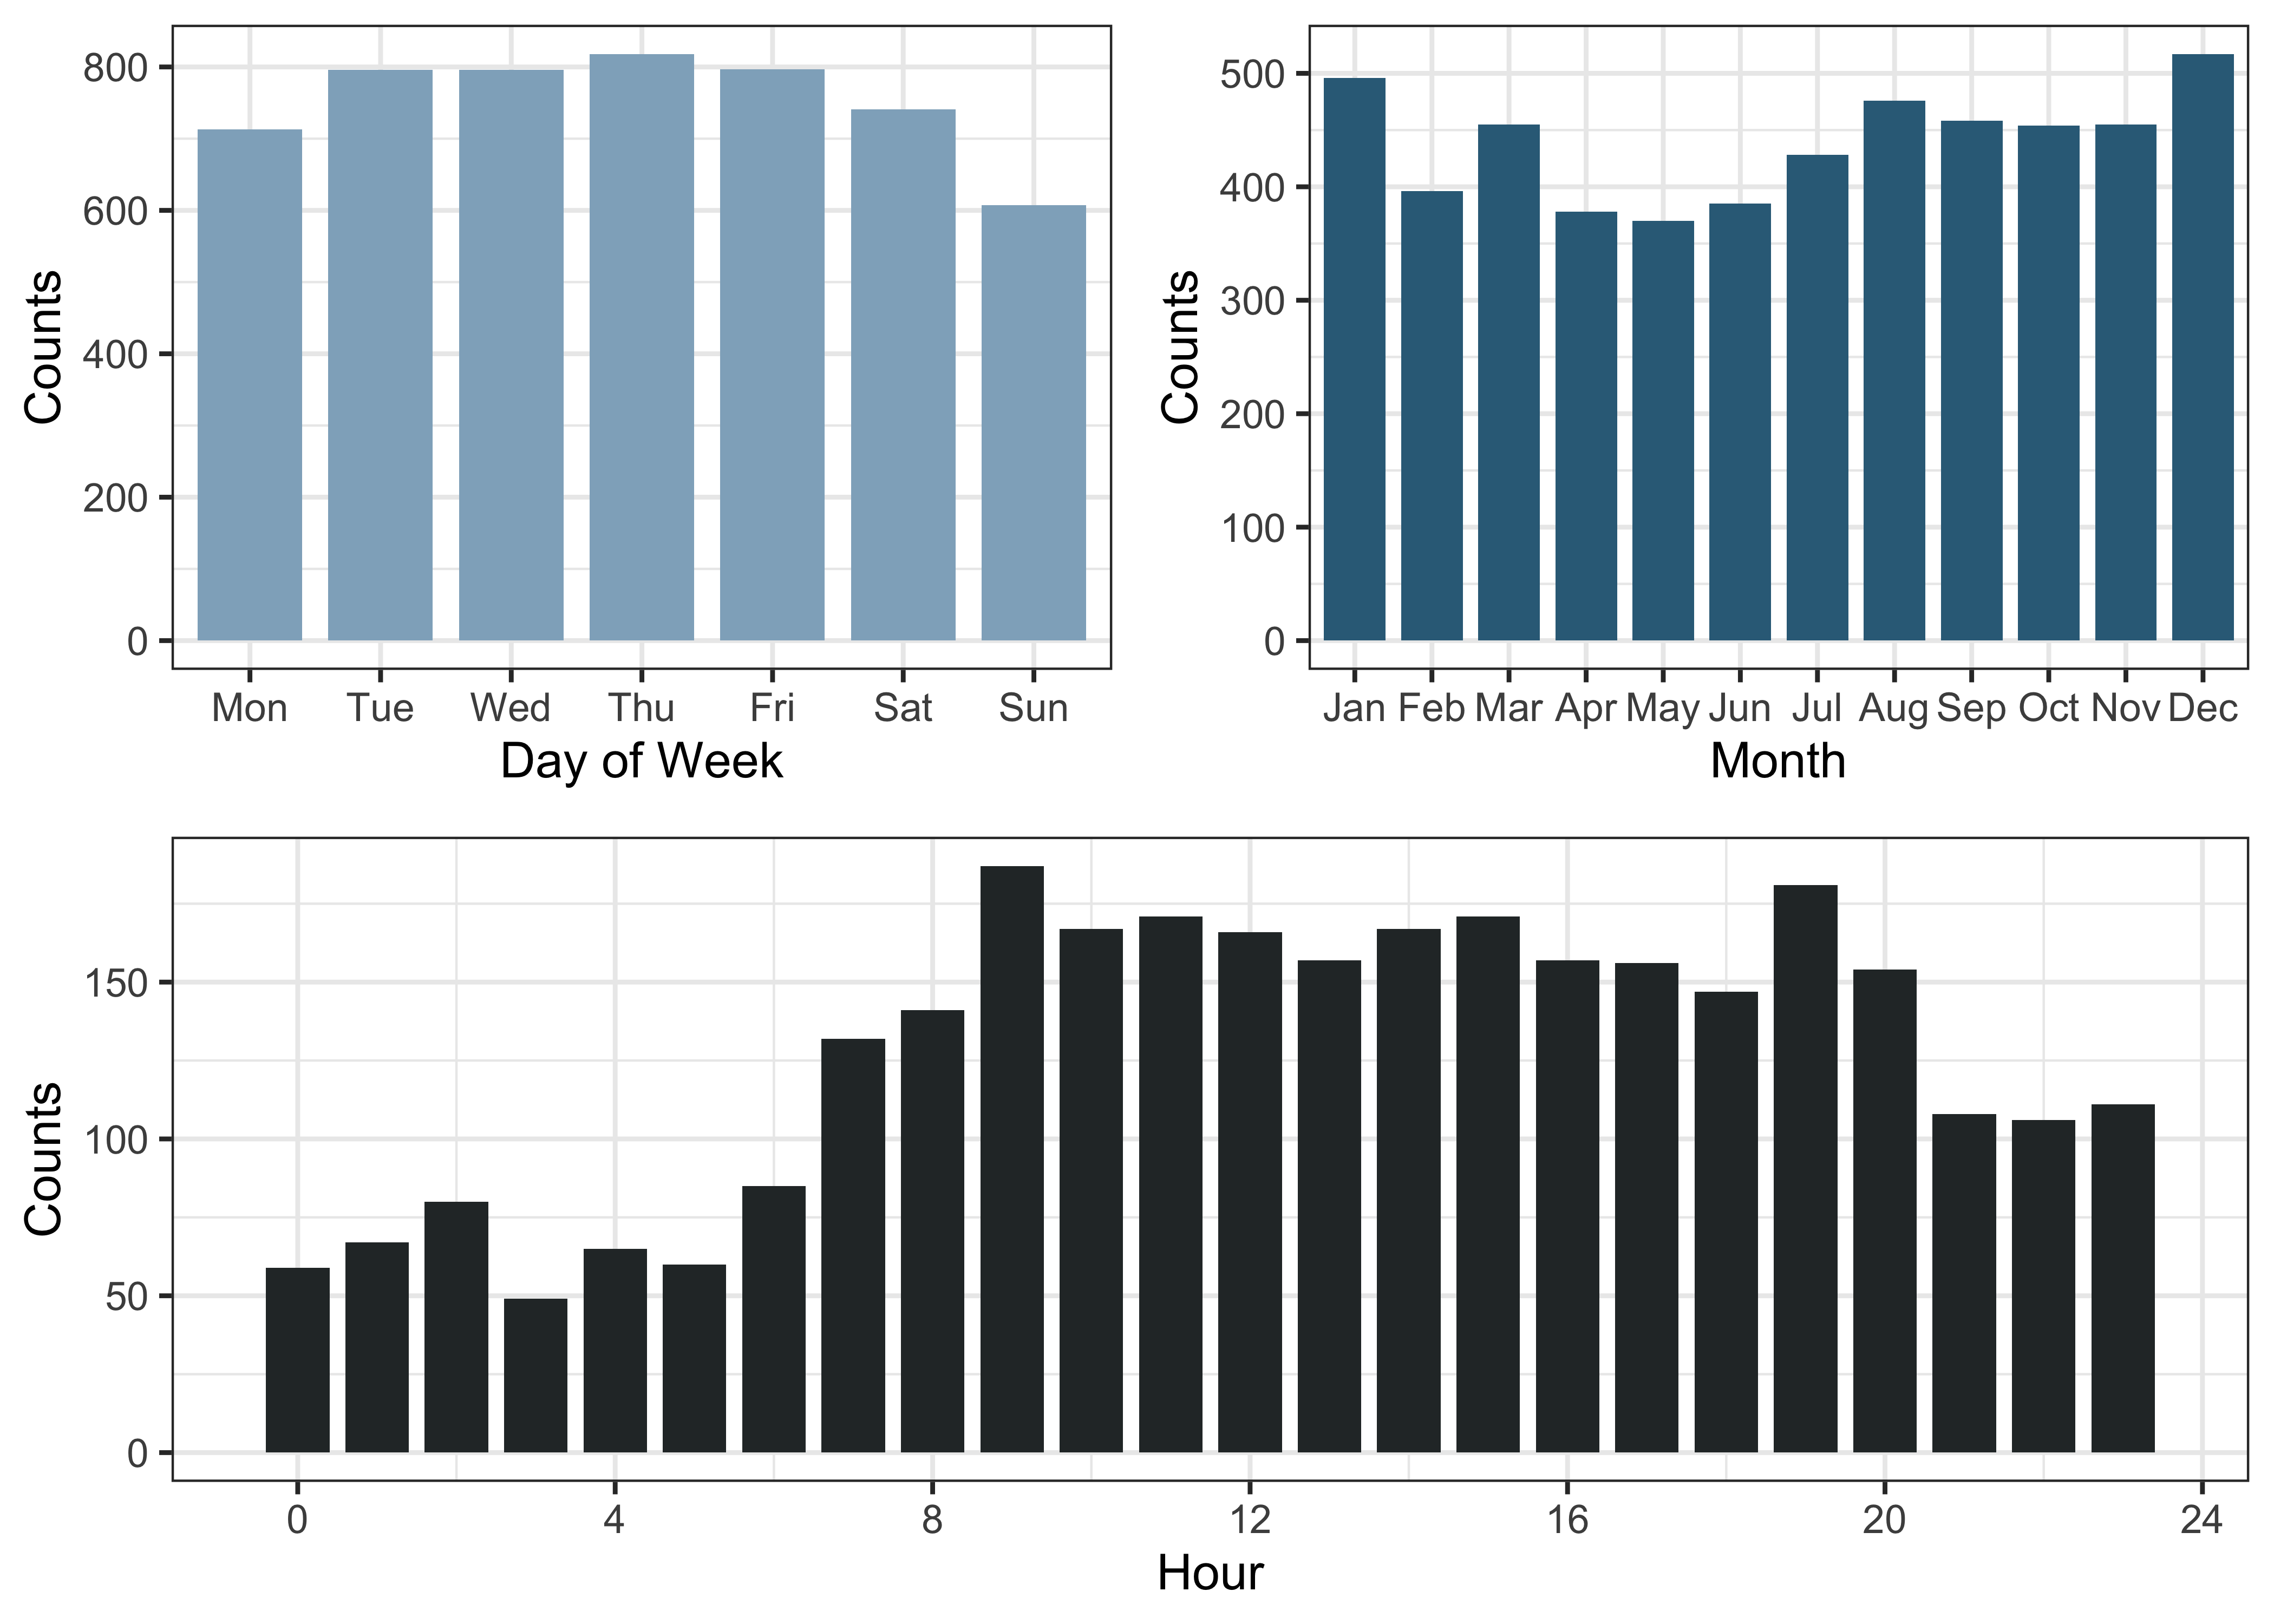
Number V.S. Time

Slide 9
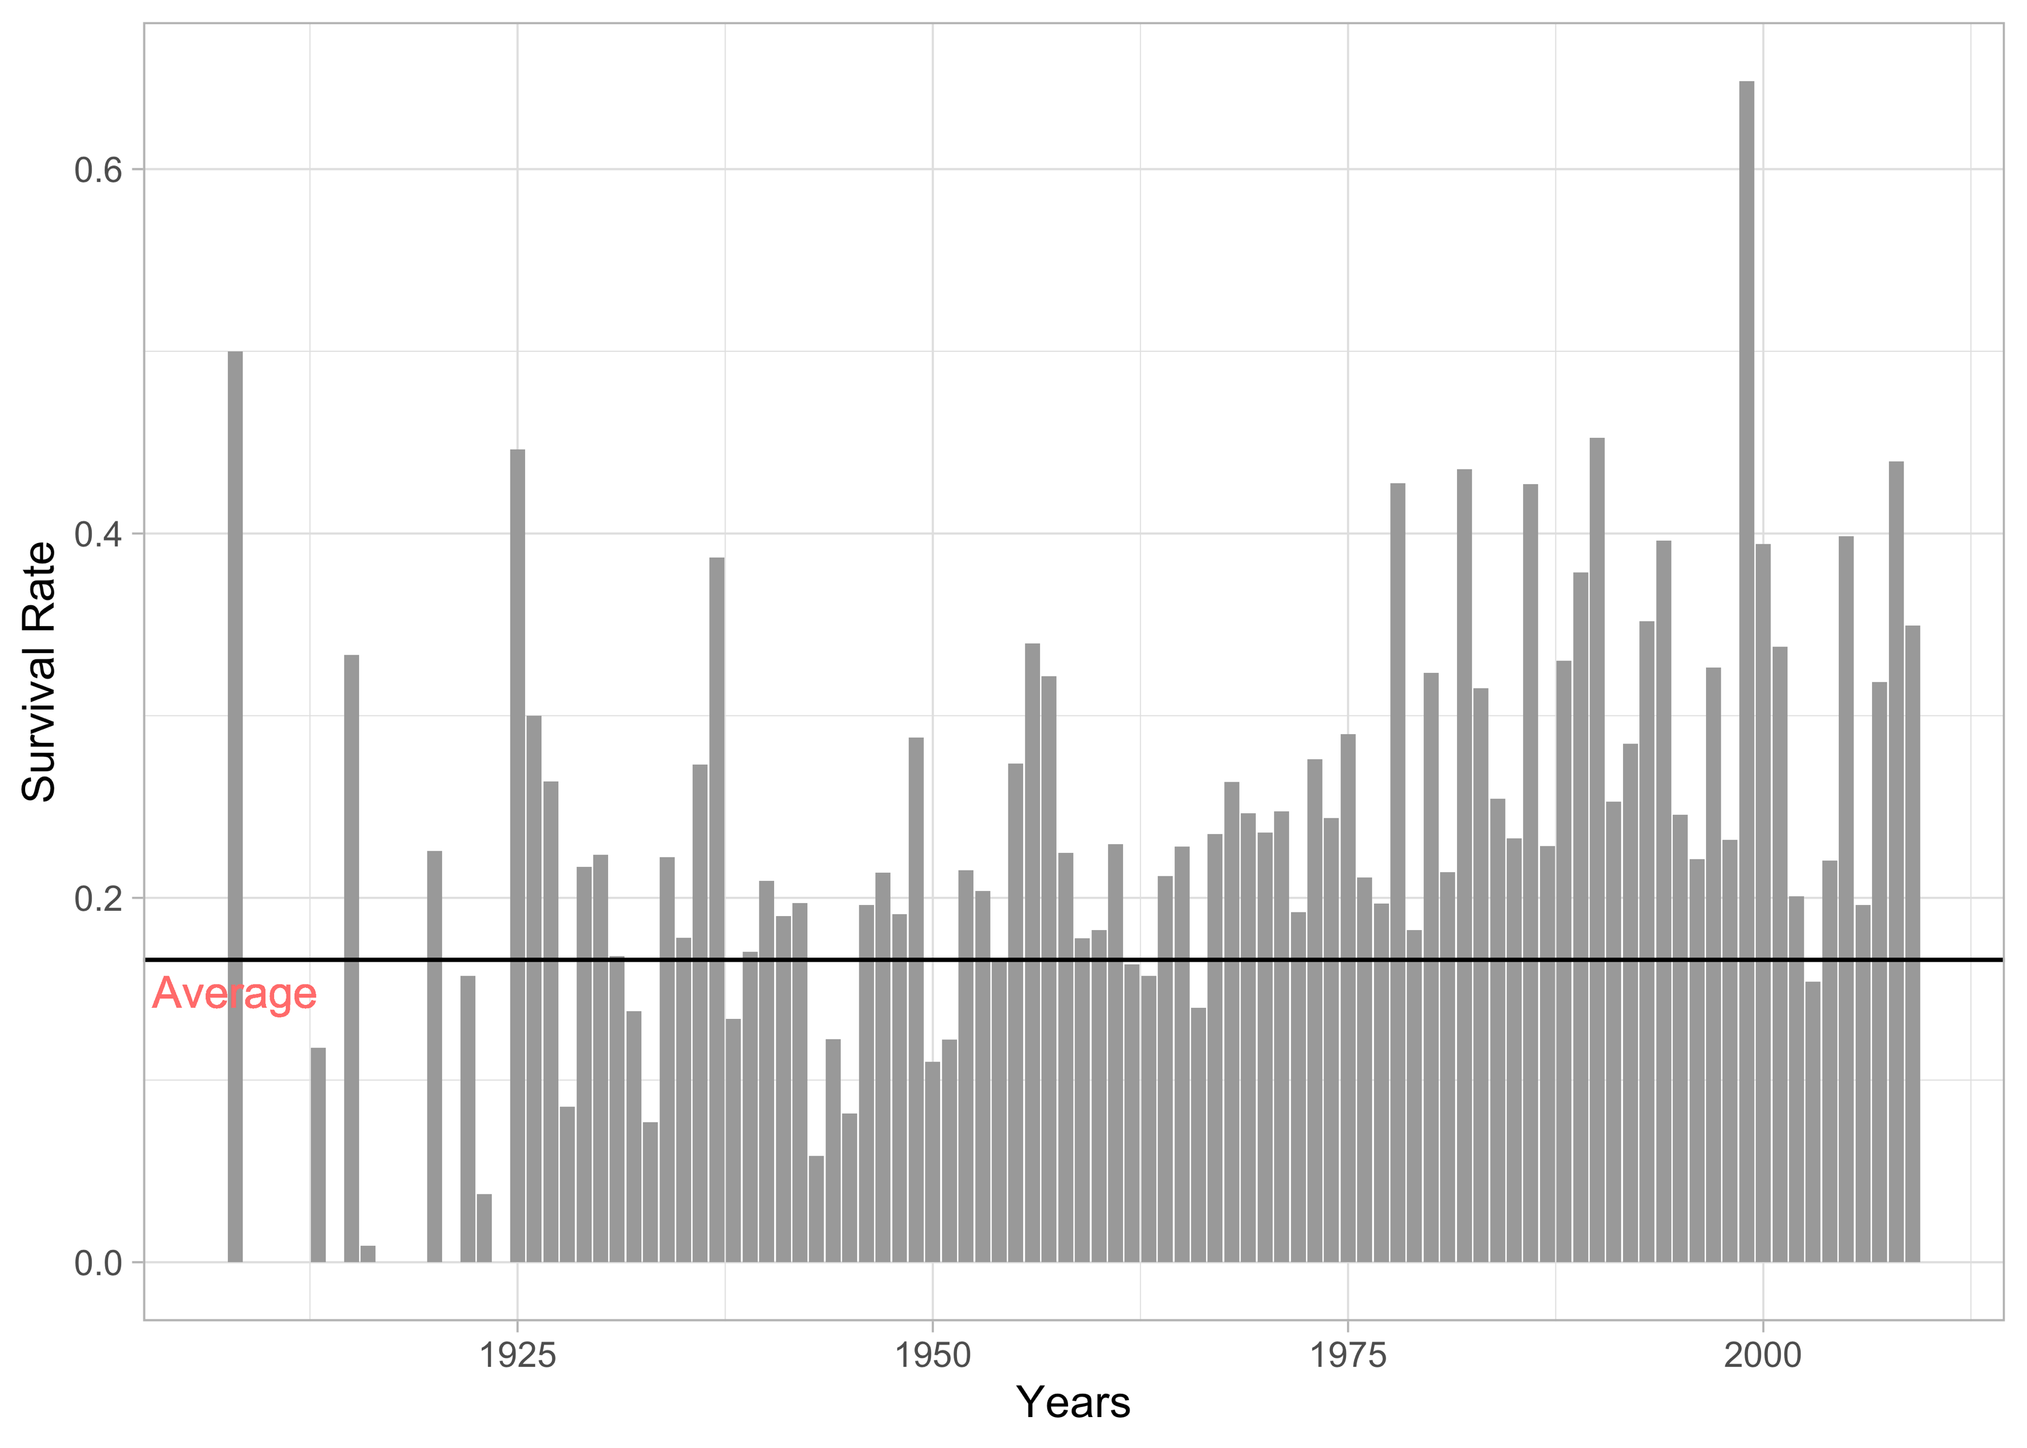
Survival Rate V.S. Time

Slide 10
03
Cluster Analysis

Slide 11
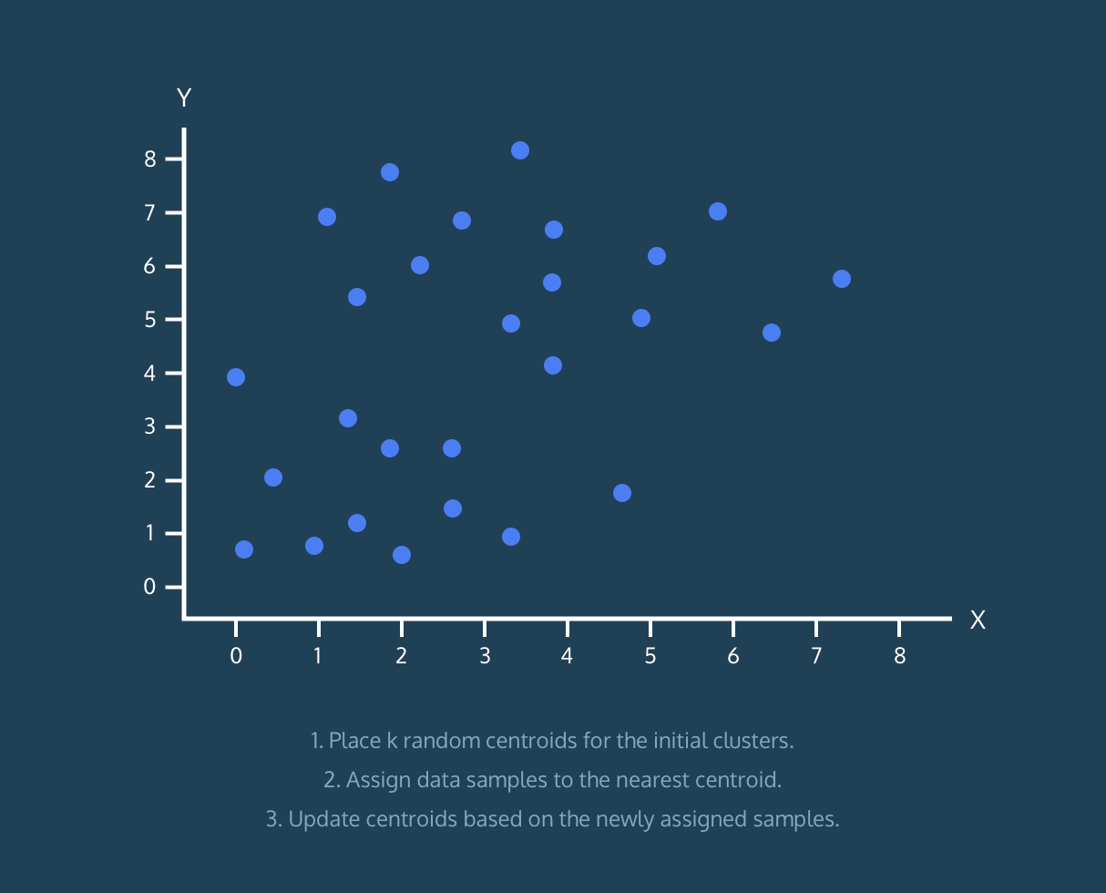
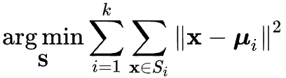
K-means
Choose the number of clusters k
Select k random points from the data as centroids
Assign all the points to the closest cluster centroid
Recompute the centroids of newly formed clusters
Repeat steps 3 and 4
Stop when centroids of newly formed clusters do not change

Slide 12
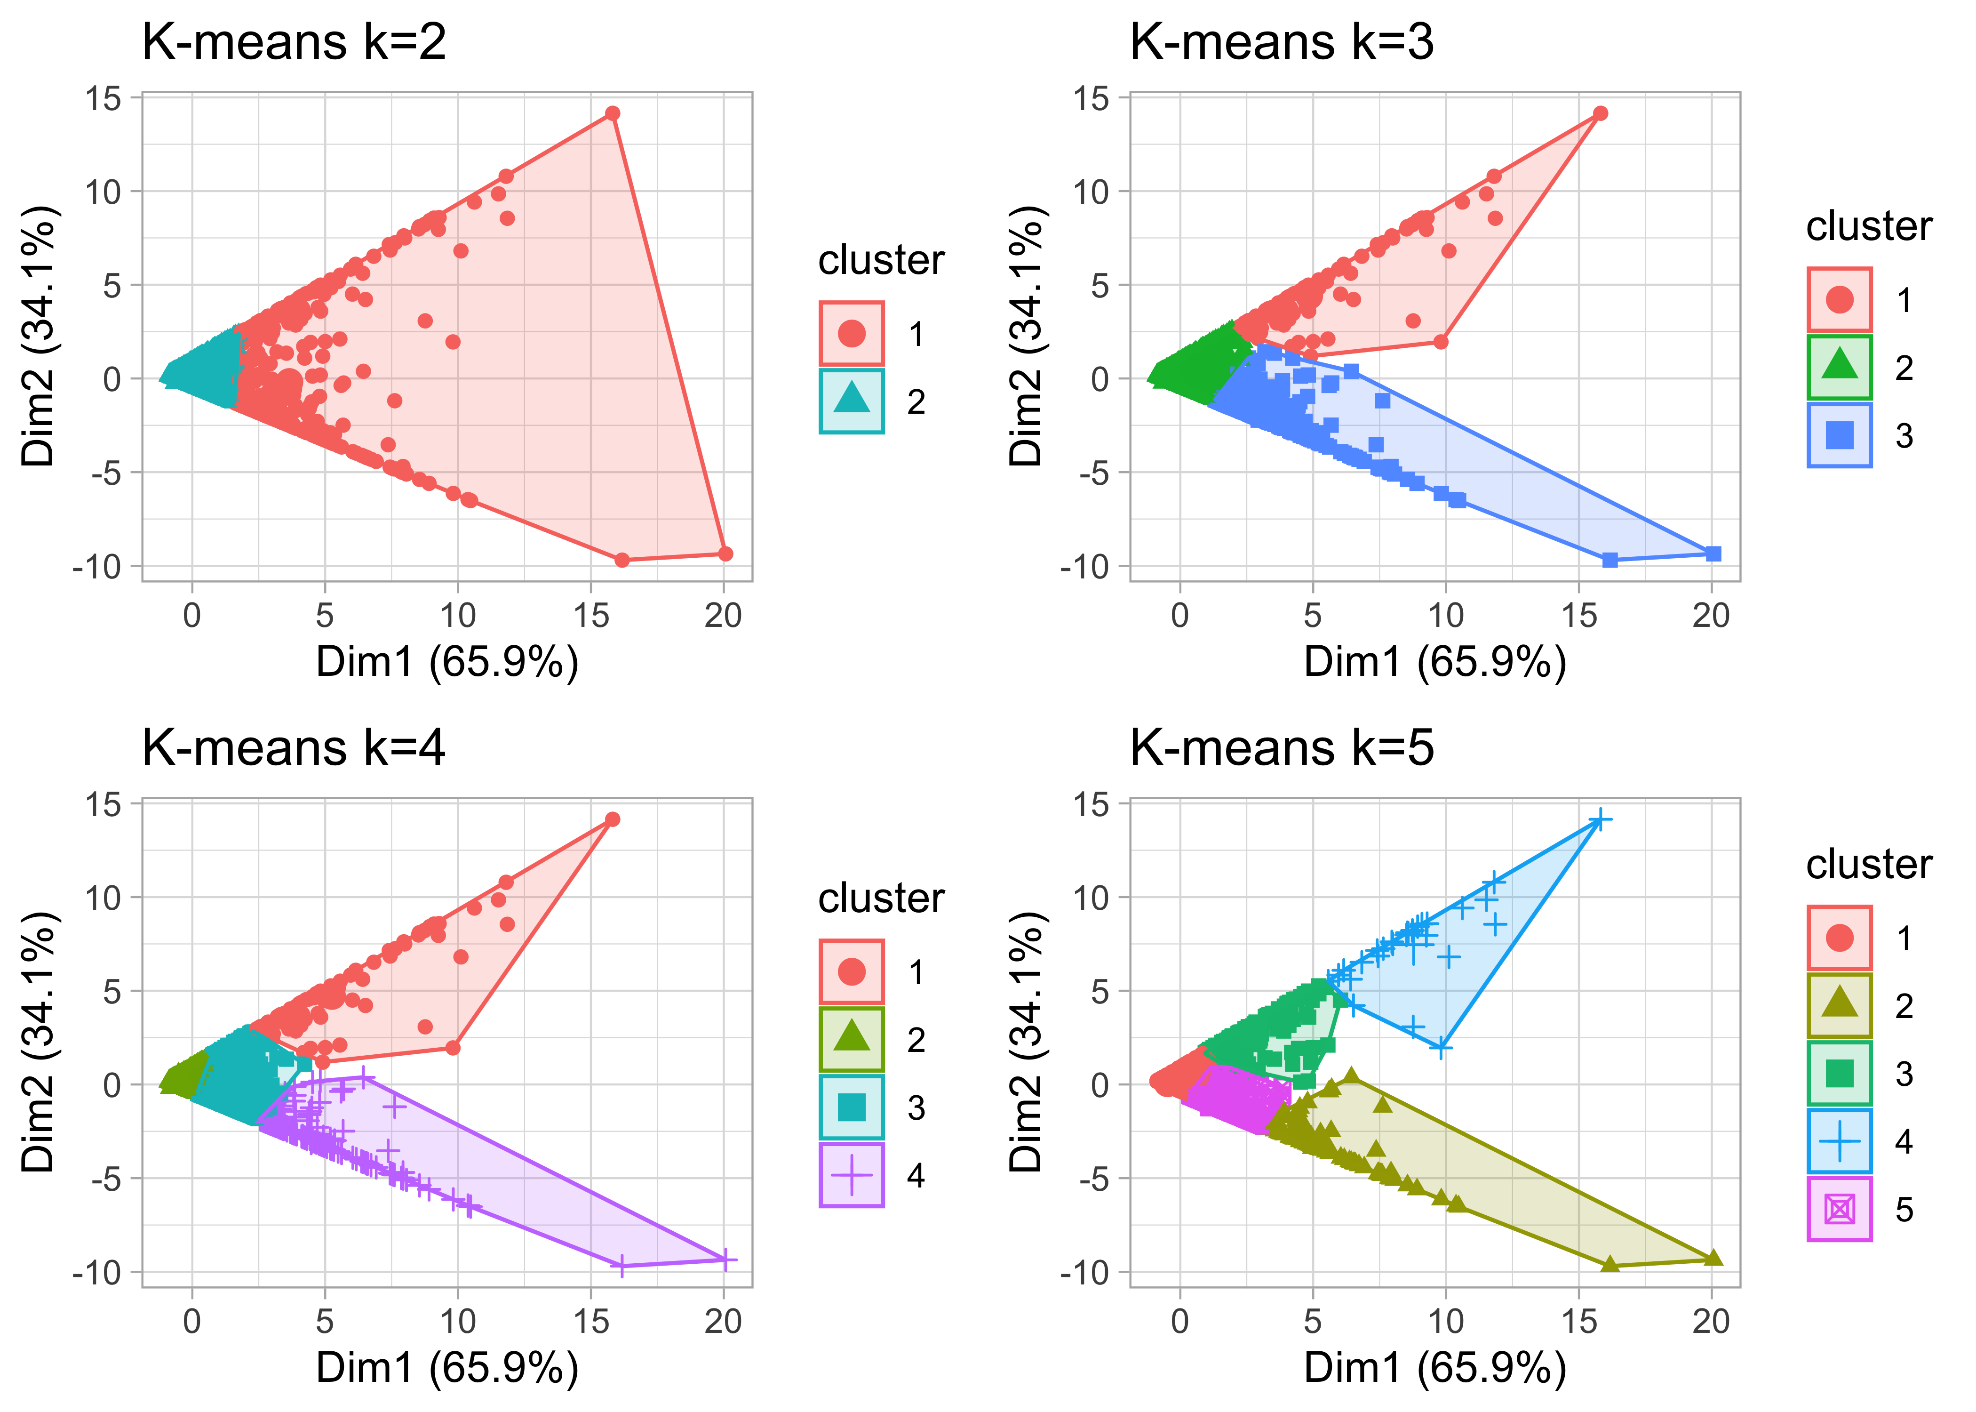
K-means

Slide 13
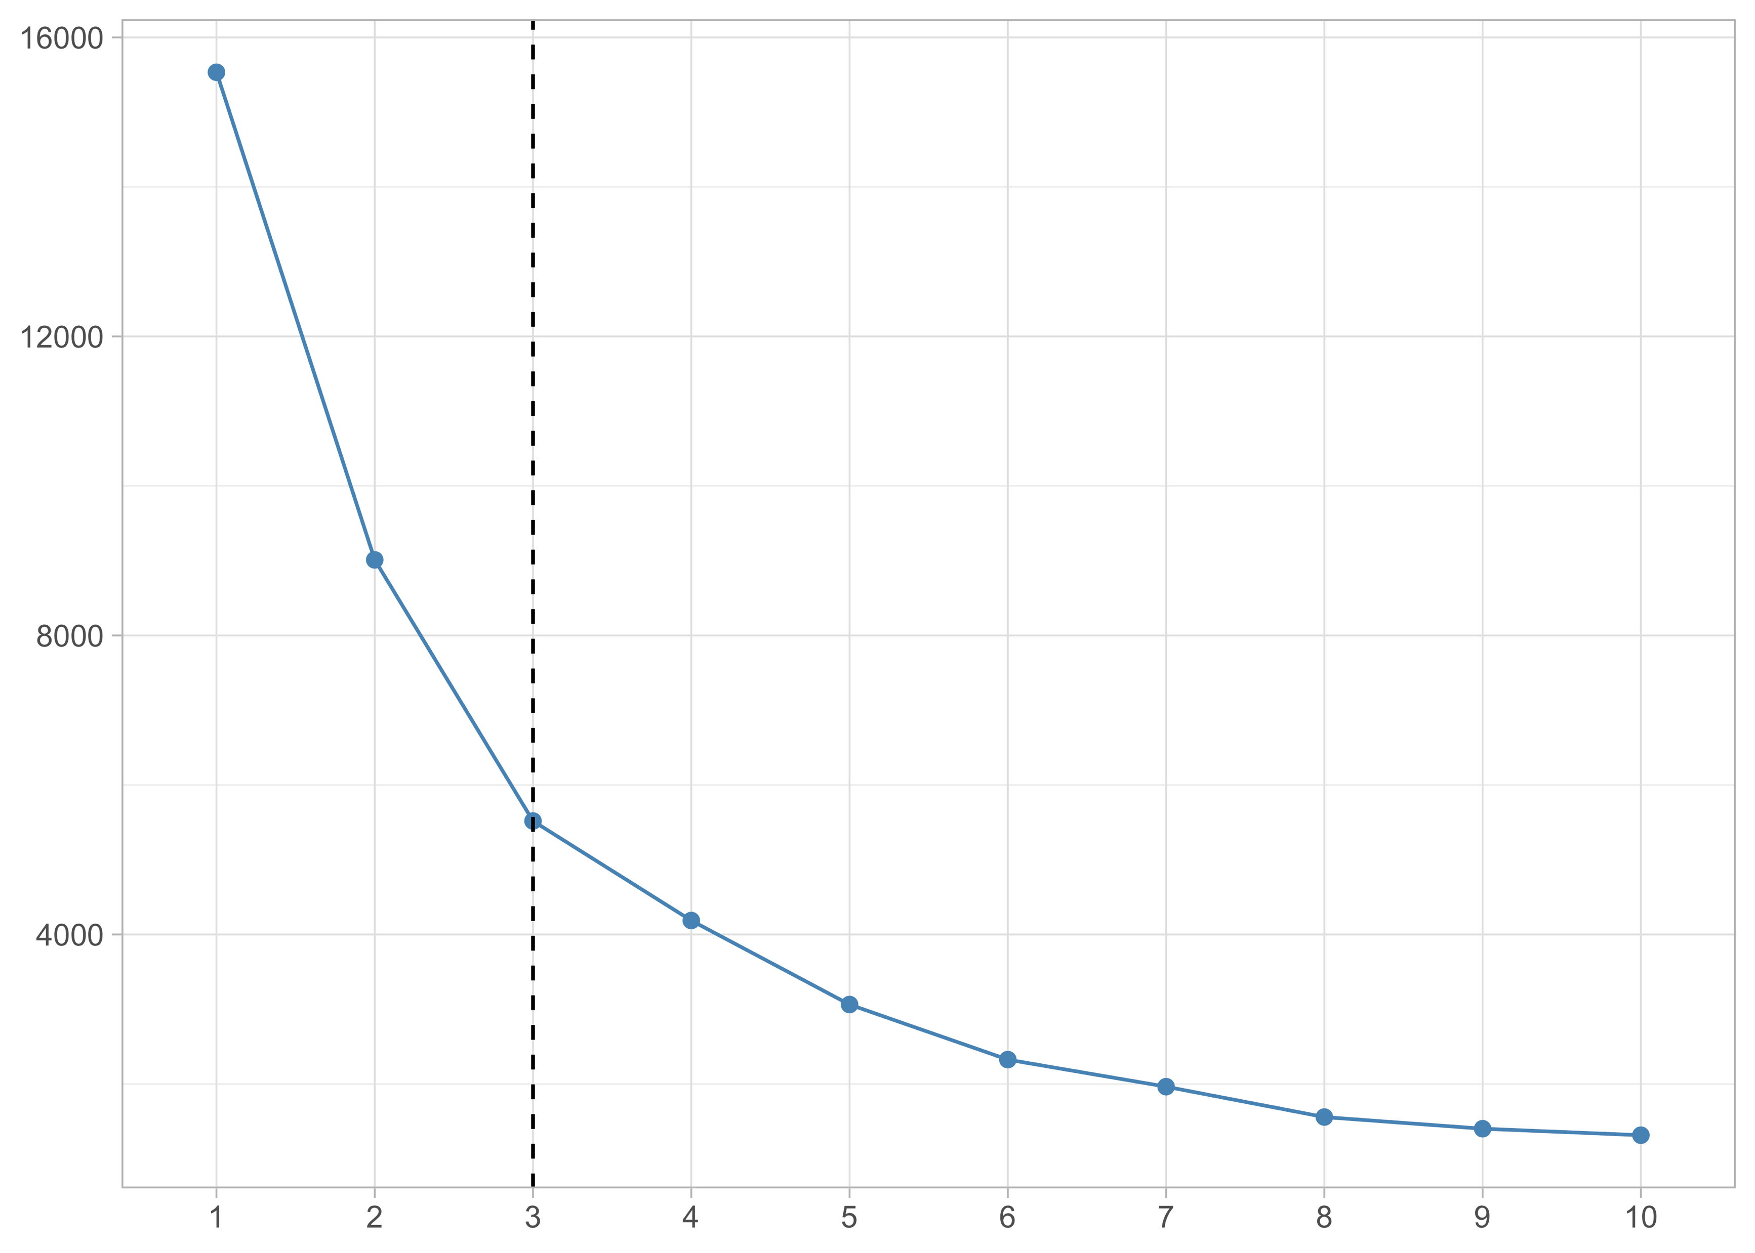
K-means
Within Sum of Square Error

Slide 14
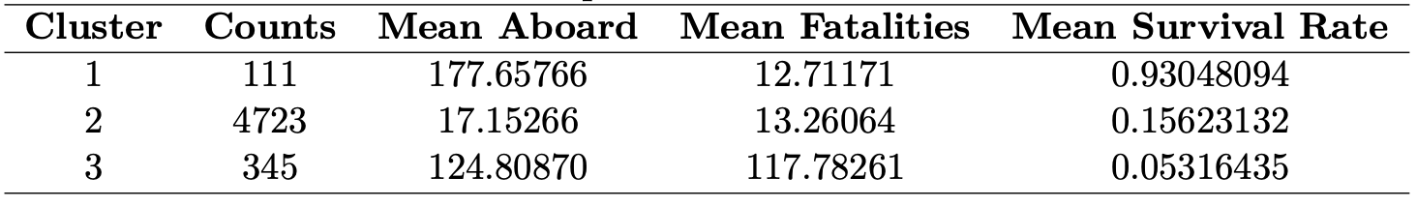
K-means
Cluster 1: Air crashes with a high survival rate 93.05%;
Cluster 2: Air crashes with an average survival rate 15.62%;
Cluster 3: Air crashes a low survival rate 5.32%.
Cluster 1: Large Passenger High Survival;
Cluster 2: Small-Midsize Crashes;
Cluster 3: Large Passenger High Fatality.

Slide 15
04
Other Factors

Slide 16
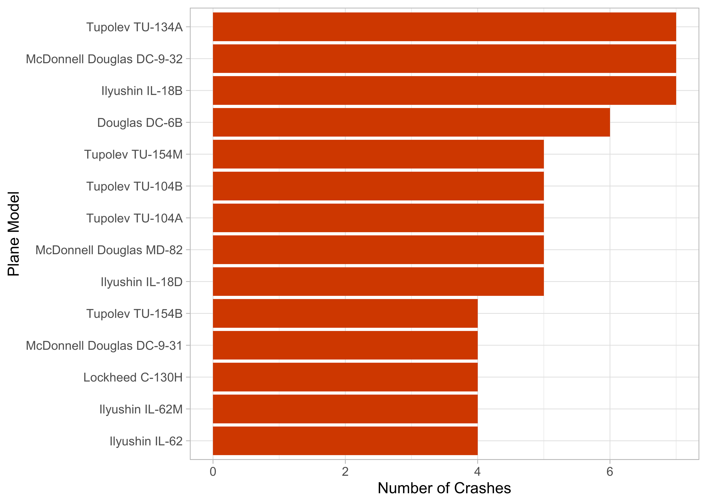
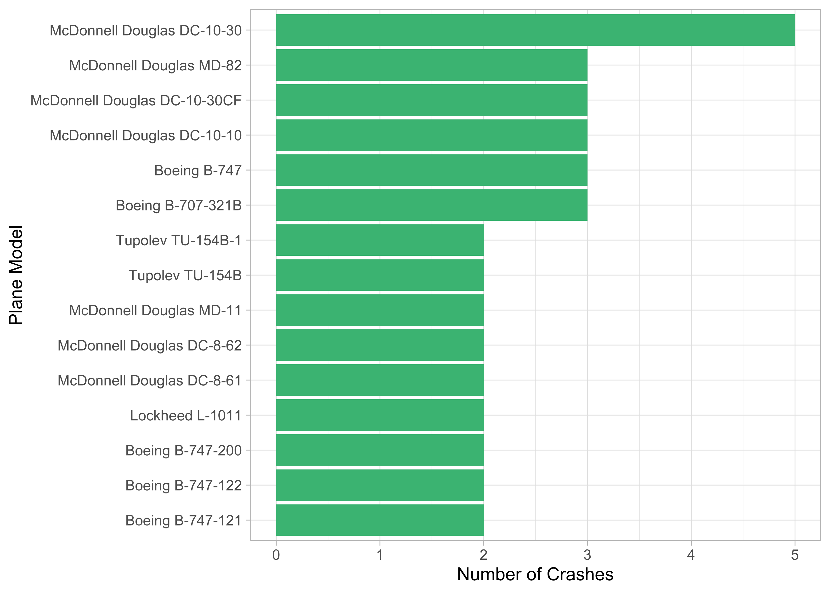
Top 10 Models
Fatality
Survival

Slide 17
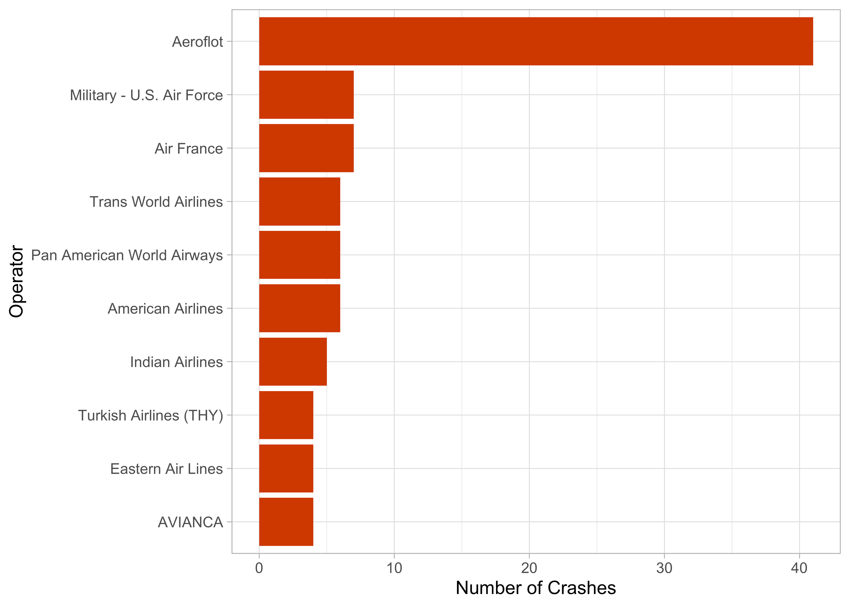
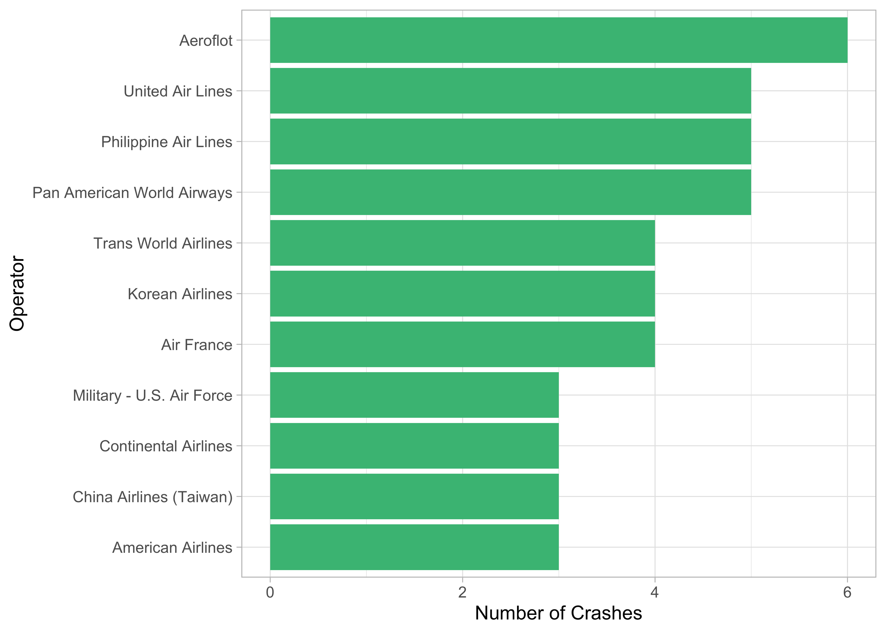
Top 10 Operator
Fatality
Survival

Slide 18
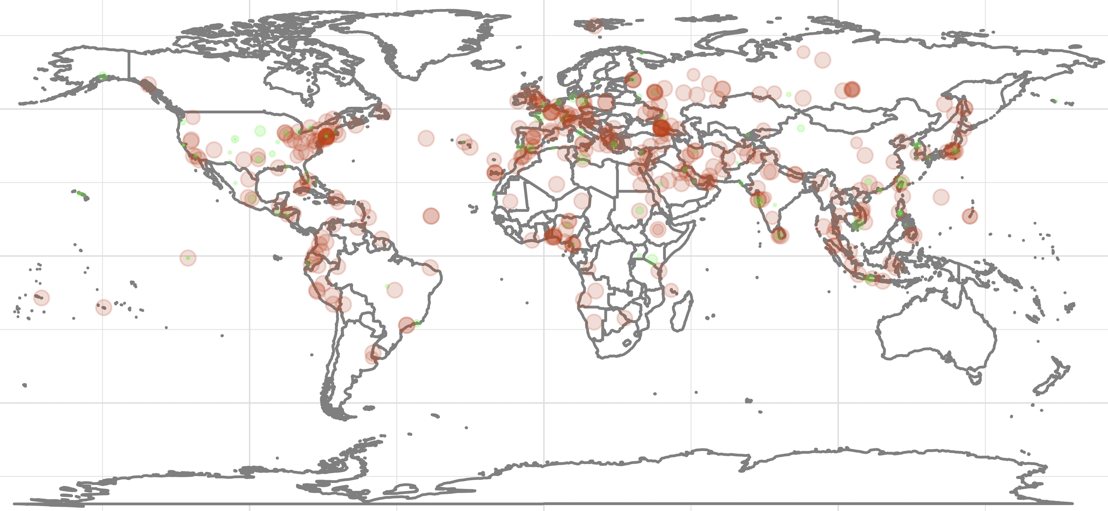
Location

Slide 19
Some useless suggestions:
Don’t fly with Aeroflot, there is 68% chance of you dying (if you meet a crash).
Try to avoid flying in small planes.

Slide 20
Questions？

